Slide 1
Design Concepts
Chapter-8 (7th Edition)

Slide 2
Software design
It is a process to transform user requirements into some suitable form, which helps the programmer in software coding and implementation.
Software design is the first step in SDLC, which moves the focus from problem domain to solution domain.
It tries to specify how to fulfill the requirements mentioned in SRS.
Done by Software Design Engineer or UI/UX designer.

Slide 3
Software design manifesto
Mitch Kapor, the creator of Lotus 1-2-3, presented a “software design manifesto” in Dr. Dobbs Journal. He said:
Good software design should exhibit:
Firmness: A program should not have any bugs that inhibit its function.
Commodity: A program should be suitable for the purposes for which it was intended.
Delight: The experience of using the program should be pleasurable one.

Slide 4
Objectives of Software Design
Correctness: Software design should be correct as per requirement.
Completeness: The design should have all the components like data structures, modules, and external interfaces, etc.
Efficiency: Resources should be used efficiently by the program.
Flexibility: Able to modify on changing needs.
Consistency: There should not be any inconsistency in the design.
Maintainability: The design should be so simple that it can be easily maintainable by other designer.

Slide 5
Software Design Process
The software design process can be divided into the following 3 levels of phases of design:
Interface design: It focused on interaction between the system and the users’ devices, scenario & behavioral based diagram used. Not focus on internal structure.
Architectural design: It focused on major components of a system their responsibilities, properties, interfaces, relationships and interactions between them. Class based & flow based diagram used.
Detailed design: It focused on internal elements of all major system components, their properties, relationships, processing, algorithms and data structures.

Slide 6
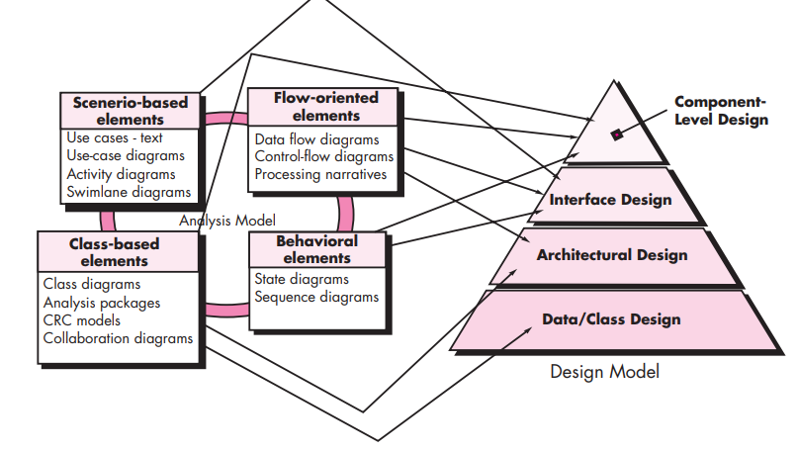
Analysis Model -> Design Model

Slide 7
Design and Quality
the design must implement all of the explicit requirements contained in the analysis model, and it must accommodate all of the implicit requirements desired by the customer.
the design must be a readable, understandable guide for those who generate code and for those who test and subsequently support the software.
the design should provide a complete picture of the software, addressing the data, functional, and behavioral domains from an implementation perspective.

Slide 8
Software Quality Guidelines
A design should exhibit an architecture that (1) has been created using recognizable architectural styles or patterns, (2) is composed of components that exhibit good design characteristics and (3) can be implemented in an evolutionary fashion
For smaller systems, design can sometimes be developed linearly.
A design should be modular; that is, the software should be logically partitioned into elements or subsystems
A design should contain distinct representations of data, architecture, interfaces, and components.
A design should lead to data structures that are appropriate for the classes to be implemented and are drawn from recognizable data patterns.
A design should lead to components that exhibit independent functional characteristics.
A design should lead to interfaces that reduce the complexity of connections between components and with the external environment.
A design should be derived using a repeatable method that is driven by information obtained during software requirements analysis.
A design should be represented using a notation that effectively communicates its meaning.

Slide 9
Software Quality Attributes
The FURPS quality attributes represent a target for all software design:
Functionality is assessed by evaluating the feature set and capabilities of the program, the generality of the functions that are delivered, and the security of the overall system.
Usability is assessed by considering human factors, overall aesthetics, consistency, and documentation.
Reliability is evaluated by measuring the frequency and severity of failure, the accuracy of output results, the mean-time-to-failure (MTTF), the ability to recover from failure, and the predictability of the program

Slide 10
Contd…
Performance is measured by considering processing speed, response time, resource consumption, throughput, and efficiency.
Supportability combines the ability to extend the program (extensibility), adaptability, serviceability—these three attributes represent a more common term, maintainability—and in addition, testability, compatibility, configurability (the ability to organize and control elements of the software configuration), the ease with which a system can be installed, and the ease with which problems can be localized.

Slide 11
Software design concepts
The software design concept simply means the idea or principle behind the design.
It describes how you plan to solve the problem of designing software.
It also shows the logic or thinking behind how you will design software.
The software design concept for developing the right software provides a supporting and essential structure or model.

Slide 12
Fundamental Concepts
Abstraction—data, procedure, control
Architecture—the overall structure of the software
Patterns—”conveys the essence” of a proven design solution
Separation of concerns—any complex problem can be more easily handled if it is subdivided into pieces
Modularity—compartmentalization of data and function
Hiding—controlled interfaces
Functional independence—single-minded function and low coupling
Refinement—elaboration of detail for all abstractions
Aspects—a mechanism for understanding how global requirements affect design
Refactoring—a reorganization technique that simplifies the design
OO design concepts—Appendix II
Design Classes—provide design detail that will enable analysis classes to be implemented

Slide 13
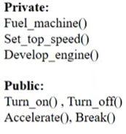
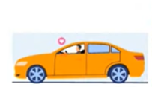
Abstraction
Abstraction is used to hide background details or unnecessary implementation about the data.
So that users see only require information.
Type 1: Procedural abstraction
There is a collection of subprograms.
One is hidden group another is visible group of functionalities.
Type 2: Data abstraction
Collections of data that describe data objects.
Show representation data & hide manipulation data.
Examples: Data structure programs directly used Push(), Pop(), Top(), and Empty() methods.

Slide 14
Data Abstraction
door
manufacturer
model number
type
swing direction
inserts
lights
type
number
weight
opening mechanism
implemented as a data structure

Slide 15
Procedural Abstraction
open
details of enter
algorithm
implemented with a "knowledge" of the
object that is associated with enter

Slide 16
Architecture
The architecture is the structure of program modules where they interact with each other in a specialized way.
“The overall structure of the software and the ways in which that structure provides conceptual integrity for a system.” [SHA95a]

Slide 17
Contd…
Structural properties. This aspect of the architectural design representation defines the components of a system (e.g., modules, objects, filters) and the manner in which those components are packaged and interact with one another. For example, objects are packaged to encapsulate both data and the processing that manipulates the data and interact via the invocation of methods
Extra-functional properties. The architectural design description should address how the design architecture achieves requirements for performance, capacity, reliability, security, adaptability, and other system characteristics.
Families of related systems. The architectural design should draw upon repeatable patterns that are commonly encountered in the design of families of similar systems. In essence, the design should have the ability to reuse architectural building blocks.

Slide 18
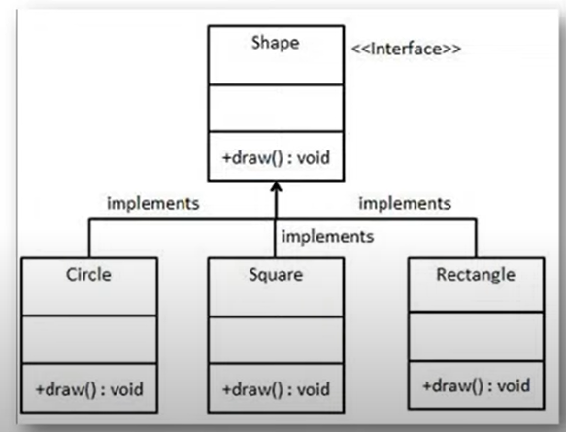
Design Patterns
The pattern simply means a repeated form of design in which the same shape is repeated several times to form a pattern.

Slide 19
Design Pattern Template
Pattern name—describes the essence of the pattern in a short but expressive name
Intent—describes the pattern and what it does
Also-known-as—lists any synonyms for the pattern
Motivation—provides an example of the problem
Applicability—notes specific design situations in which the pattern is applicable
Structure—describes the classes that are required to implement the pattern
Participants—describes the responsibilities of the classes that are required to implement the pattern
Collaborations—describes how the participants collaborate to carry out their responsibilities
Consequences—describes the “design forces” that affect the pattern and the potential trade-offs that must be considered when the pattern is implemented
Related patterns—cross-references related design patterns

Slide 20
Separation of Concerns
Any complex problem can be more easily handled if it is subdivided into pieces that can each be solved and/or optimized independently
A concern is a feature or behavior that is specified as part of the requirements model for the software
By separating concerns into smaller, and therefore more manageable pieces, a problem takes less effort and time to solve.

Slide 21
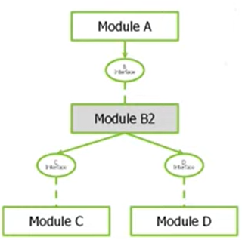
Modularity
Modularity simply means dividing the system or project into smaller parts to reduce the complexity of the system or project.
After developing the modules, they are integrated together to meet the software requirements.
Modularizing a design helps to effective development, accommodate changes easily, conduct testing, debugging efficiently and conduct maintenance work easily.

Slide 22
Contd…
"modularity is the single attribute of software that allows a program to be intellectually manageable" [Mye78].
Monolithic software (i.e., a large program composed of a single module) cannot be easily grasped by a software engineer.
The number of control paths, span of reference, number of variables, and overall complexity would make understanding close to impossible.
In almost all instances, you should break the design into many modules, hoping to make understanding easier and as a consequence, reduce the cost required to build the software.

Slide 23
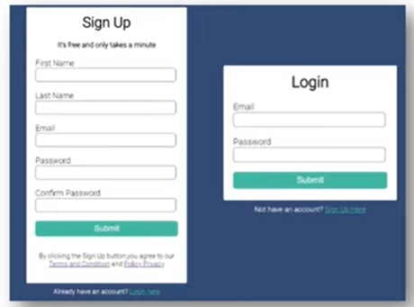
Information Hiding
Modules should be specified and designed in such a way that the data structures and algorithm details of one module are not accessible to other modules.
They pass only that much information to each other, which is required to accomplish the software functions.
The way of hiding unnecessary details in modules is referred to as information hiding.

Slide 24
Information Hiding
module
• algorithm
controlled
interface
• data structure
• details of external interface
• resource allocation policy
clients
"secret"
a specific design decision

Slide 25
Why Information Hiding?
reduces the likelihood of “side effects”
limits the global impact of local design decisions
emphasizes communication through controlled interfaces
discourages the use of global data
leads to encapsulation—an attribute of high quality design
results in higher quality software

Slide 26
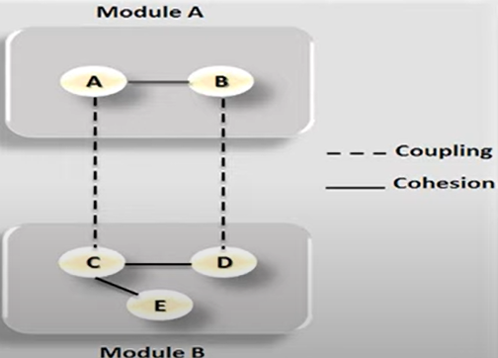
Functional Independence
The functional independence is the concept of separation and related to the concept of modularity, abstraction and information hiding.
Criteria 1: Coupling
The degree in which module is “connected” to other module in the system.
Low coupling necessary in good software.
Criteria 2: Cohesion
The degree in which module perform functions in inner module in the system.
High cohesion necessary in good software.

Slide 27
Functional Independence
Functional independence is achieved by developing modules with "single-minded" function and an "aversion" to excessive interaction with other modules.
Cohesion is an indication of the relative functional strength of a module.
A cohesive module performs a single task, requiring little interaction with other components in other parts of a program. Stated simply, a cohesive module should (ideally) do just one thing.
Coupling is an indication of the relative interdependence among modules.
Coupling depends on the interface complexity between modules, the point at which entry or reference is made to a module, and what data pass across the interface.

Slide 28
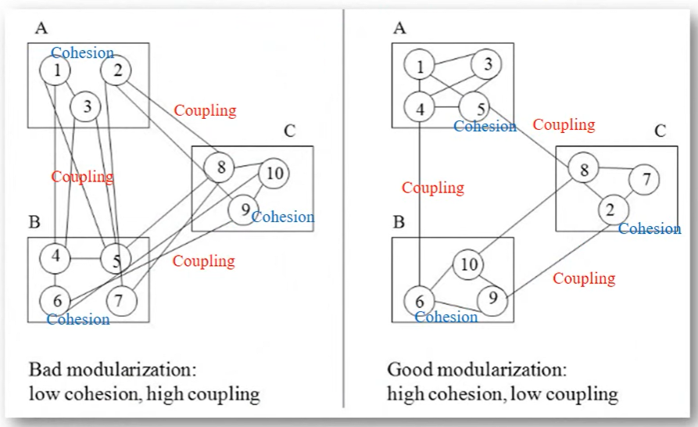
Good and Bad software design

Slide 29
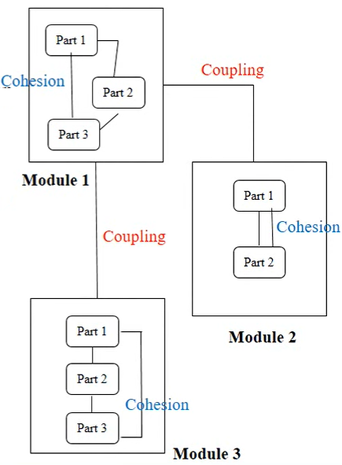
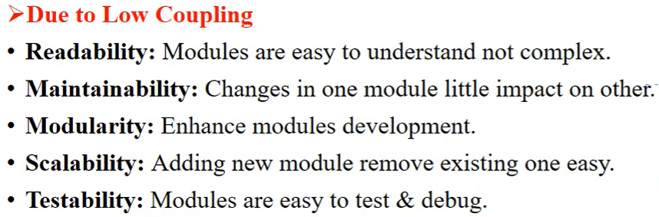
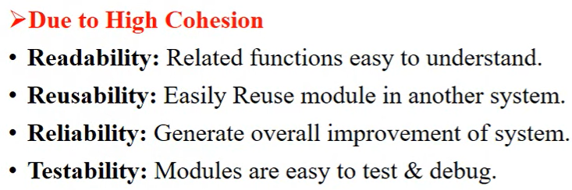
Why high cohesion and low coupling generate good design?

Slide 30
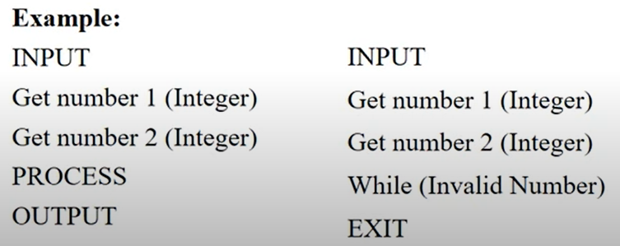
Refinement
It is a top-down design approach and a process of elaboration.
A program is established for refining levels of procedural details.
A hierarchy is established by decomposing a statement of function in a stepwise manner till the programming language statement are reached.

Slide 31
Stepwise Refinement
open
walk to door;
reach for knob;
open door;
repeat until door opens
turn knob clockwise;
walk through;
if knob doesn't turn, then
close door.
take key out;
find correct key;
insert in lock;
endif
pull/push door
move out of way;
end repeat

Slide 32
Aspects
Consider two requirements, A and B. Requirement A crosscuts requirement B “if a software decomposition [refinement] has been chosen in which B cannot be satisfied without taking A into account. [Ros04]
An aspect is a representation of a cross-cutting concern.

Slide 33
Aspects—An Example
Consider two requirements for the SafeHomeAssured.com WebApp. Requirement A is described via the use-case Access camera surveillance via the Internet. A design refinement would focus on those modules that would enable a registered user to access video from cameras placed throughout a space. Requirement B is a generic security requirement that states that a registered user must be validated prior to using SafeHomeAssured.com. This requirement is applicable for all functions that are available to registered SafeHome users. As design refinement occurs, A* is a design representation for requirement A and B* is a design representation for requirement B. Therefore, A* and B* are representations of concerns, and B* cross-cuts A*.
An aspect is a representation of a cross-cutting concern. Therefore, the design representation, B*, of the requirement, a registered user must be validated prior to using SafeHomeAssured.com, is an aspect of the SafeHome WebApp.

Slide 34
Refactoring
Fowler [FOW99] defines refactoring in the following manner:
"Refactoring is the process of changing a software system in such a way that it does not alter the external behavior of the code [design] yet improves its internal structure.”
When software is refactored, the existing design is examined for
redundancy
unused design elements
inefficient or unnecessary algorithms
poorly constructed or inappropriate data structures
or any other design failure that can be corrected to yield a better design.

Slide 35
OO Design Concepts
Design classes
Entity classes
Boundary classes
Controller classes
Inheritance—all responsibilities of a superclass is immediately inherited by all subclasses
Messages—stimulate some behavior to occur in the receiving object
Polymorphism—a characteristic that greatly reduces the effort required to extend the design

Slide 36
Design Classes
Analysis classes are refined during design to become entity classes
Boundary classes are developed during design to create the interface (e.g., interactive screen or printed reports) that the user sees and interacts with as the software is used.
Boundary classes are designed with the responsibility of managing the way entity objects are represented to users.
Controller classes are designed to manage
the creation or update of entity objects;
the instantiation of boundary objects as they obtain information from entity objects;
complex communication between sets of objects;
validation of data communicated between objects or between the user and the application.

Slide 37
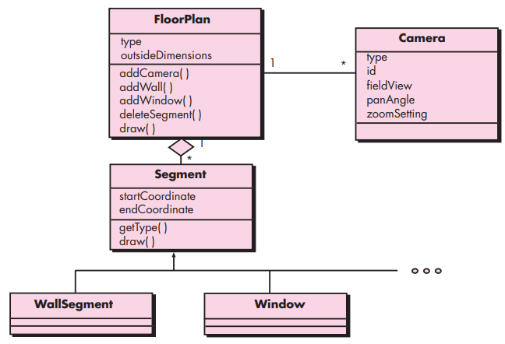
The design model

Slide 38
Design Model Elements
Data elements
Data model --> data structures
Data model --> database architecture
Architectural elements
Application domain
Analysis classes, their relationships, collaborations and behaviors are transformed into design realizations
Patterns and “styles”
Interface elements
the user interface (UI)
external interfaces to other systems, devices, networks or other producers or consumers of information
internal interfaces between various design components.
Component elements
Deployment elements

Slide 39
Architectural Elements
The architectural model [Sha96] is derived from three sources:
information about the application domain for the software to be built;
specific requirements model elements such as data flow diagrams or analysis classes, their relationships and collaborations for the problem at hand, and
the availability of architectural patterns and styles.

Slide 40
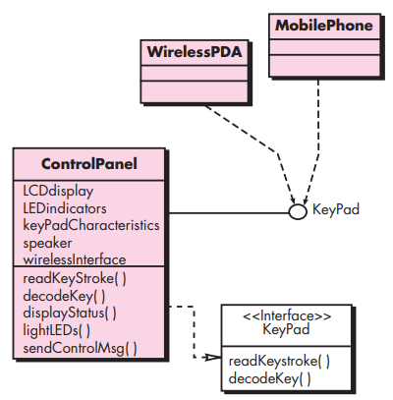
Interface Elements

Slide 41
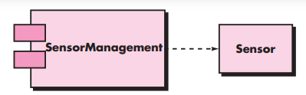
Component Elements

Slide 42
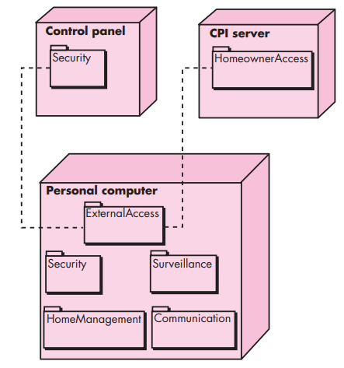
Deployment Elements

Slide 43
Reference
Software Engineering: A Practitioner’s Approach, 7/e by Roger S. Pressman

